Slide 1
AI CONTINUOUS ENTERPRISE SUCCESS PLATFORM
AICESP
Input a business requirement — strategy analysis → system design → code → acceptance.
The entire chain executed by machine.
Requirement, design & code delivery packages — with a full set of specification documents — auto-produced end-to-end within the day.
106 specialized AI agents
20 invention patents pending
6 industry knowledge bases
AEBT methodology
Yandie Intelligent Technology (Beijing) Co., Ltd. · www.myaiarch.com · 2026

Slide 2
WHY NOW
Two curves have just crossed
Coding agents cross the whole-system-generation threshold × domestic inference cost in free fall — a window that didn't exist two years ago. The crossing point is now.
AI's center of gravity is shifting from compute to applications. Today's app layer looks exactly like foundation models did right before that window closed: the inflection is past, consensus hasn't formed, first-movers are already compounding.
The winning move isn't 'wiring up an API' — it's making the whole value chain (strategy → process → delivery → improvement) AI-native. Whoever turns AI into machine-acceptable business results closes out the application layer.
Our flywheel already turns: one quality lesson from a government project → a general constraint → auto-inherited by a banking project, Critical=0 on the first round. Every new industry inherits the full history at launch.
You don't need to trust us — 10 minutes is enough to verify: real system + production-process replay + full source code (next page shows how).
AICESP · Yandie Intelligent Technology (Beijing) Co., Ltd. · www.myaiarch.com
2 / 26

Slide 3
LIVE PROOF
Due diligence, inverted
Don't trust a single slide — verify it live. Government sector · live production-line run · real execution log (1 auto-repair loop) · reproducible on the spot.
aicesp — live production line
$ Requirement-analysis engine starting
AEBT L1 · Strategy: 42 entities · 17 architecture constraints · 0 ambiguities ✓
AEBT L2 · Requirement spec generated · Critical QC: 0 defects ✓
AEBT L3 · 11 microservices · 27 data tables · 53 API contracts ✓
CODEGEN · code generation 100% complete ✓
QA-16D · Acceptance loop 1: BLOCKED · P0×1 (doc status drifted from the requirement contract)
AUTO-FIX · Adjudicator CONFIRM → surgical enum realignment · consistency recompute · constraint written back to the platform
QA-16D · Acceptance loop 2: PASS×16 · Critical=0 · Warnings=3 (non-blocking) · flywheel iterated ✓
KB-SYNC · enum drift → general constraint → auto-validated in banking & manufacturing, so the drift never recurs ✓
Fastest clean full chain 4.3 hours (requirements 30 min + design 48 min + code 3 hours) · requirement analysis as fast as 26 minutes · runnable system ready
Output: requirement package 9 docs · design package 6 docs · development package (full source + 4 docs). Name the scenario on the spot — we run it on the spot. No rehearsal · no cherry-picking · no prep.
AICESP · Yandie Intelligent Technology (Beijing) Co., Ltd. · www.myaiarch.com
3 / 26

Slide 4
THE PROBLEM
Where's the competitive advantage?
So much spent on digital, yet analysis / delivery / improvement all break — verified across government, central SOEs and banking.
Broken link
Status quo
AICESP fixes it
① Strategy never lands
Consultants charge for the analysis, not for landing it — they leave the moment the report is handed over.
An AI consultant delivers an action list in hours, on duty 7×24.
② Software forces process compromise
Built to the vendor's logic — 60% of the business goes live, 40% is left at the edges.
A fully custom system generated from scratch, accepted by machine.
③ Improvement resets to zero
A system is legacy the day it ships; improving means a new project and a new tender.
The four-step flywheel runs 7×24 automatically, zero human trigger.
Three-industry proof Government 138 files · 43/43 acceptance · 149 endpoints zero bypass | Enterprise 195 files · 21/21 · 95 endpoints zero bypass | Central SOE 11-system classified governance · 12 docs (internal exercise)
AICESP · Yandie Intelligent Technology (Beijing) Co., Ltd. · www.myaiarch.com
4 / 26

Slide 5
THE SOLUTION
A closed-loop vertical value chain
Not 'auto-writing code' but an unbreakable vertical chain — what fundamentally sets AICESP apart from every 'AI tool'.
Strategic
goals
Business
vision
Value Creation
Web (VCW)
AI-empowered
process redesign
Requirement →
design → code
Run & optimize
flywheel
A loop, not a chain: go-live is the start of the flywheel — AI always serves the strategy, never spins off-chain.
North Star
Under AI empowerment, redesign the enterprise's end-to-end processes, build new capabilities, and create value more distinctive and richer than rivals'.
Quality red line ①
The output must be a coherent end-to-end process redesign (AI becomes the subject; steps are reconstructed or disappear) — never a 'pile of isolated AI agents'.
Quality red line ②
Every AI enabler is traceable along the chain: process → new capability → value → advantage → vision → strategic goal. Isolated & untraceable = out of focus = fail.
Deliverables
Others stop at handing over code; AICESP hands over 'capability + flywheel'.
AICESP · Yandie Intelligent Technology (Beijing) Co., Ltd. · www.myaiarch.com
5 / 26

Slide 6
THE BIG IDEA
Software is just Instance #1
At its core AICESP is a domain-general, self-governing, self-evolving engine — 'requirement → design → develop → optimize' is only its first instance.
Instance #1 · Enterprise software
Instance #2 · Running ourselves
Instance #N · Broader domains
(verified · reproducible)
(emerging)
(trajectory)
Software ships with its own compiler / tests = a free referee, so feedback and self-evolution are fastest — which is why we lit this instance first. The four-stage line delivers a complete runnable system, end to end.
The same engine in the 'operating AICESP' domain: strategy / process / iteration / daily ops run by AI, humans handling only creativity and exceptions. Self-evolution watch-lines, channel outreach and collateral already run here.
Strategy / research / operations / complex-system design — where expert teams work for months and there is no compiler. The barrier to a new domain isn't the engine, but 'who acts as the referee'.
The moat: other domains have no free compiler. This engine's truly unique capability is manufacturing verification where no referee exists (adversarial multi-model verification · deterministic gates · simulation · decaying human-in-the-loop). Opening a new domain isn't a gate to conquer first — it is the very reason this engine exists. The TAM isn't capped at software outsourcing, but 'autonomous long-horizon projects in any domain'.
In candor: Instance #1 is fully verified and self-governing; self-evolution is still early — what we sell is not 'already fully autonomous' but a positive slope. This is the axis that separates us from the 'strong people make strong output' path: we bet the system evolves itself.
AICESP · Yandie Intelligent Technology (Beijing) Co., Ltd. · www.myaiarch.com
6 / 26

Slide 7
ARCHITECTURE
Five subsystems + one shared foundation
Module autonomy · contract-driven · one-way dependency · separation of duties — subsystems pass only structured contracts, traceable throughout.
Requirement
subsystem
3-stage analysis: vision → process redesign → spec · 51 agents + industry packs
design_ready_package (5-piece set)
Design
subsystem
3-stage: high-level → detailed → generability hardening · 30 agents
High-generability design + certificate
Development
subsystem
Context prep → Claude Code coder writes it → quality pipeline
Runnable source + tests + delivery package
Optimization
subsystem
EFIL loop + self-configuring monitoring → new requirements fed back into the line
Improvement requirements + case memory
Governance hub
A 'Ming Cabinet' with three-way checks arbitrates high-risk calls; humans as final adjudicator (HITL)
Decision arbitration
Shared foundation: LLMFactory (single LLM entry) · shared contracts · knowledge packs · three-model adversarial adjudication · DocEngine
Main axis: requirement → design → develop → optimize (flywheel)
AICESP · Yandie Intelligent Technology (Beijing) Co., Ltd. · www.myaiarch.com
7 / 26

Slide 8
PROOF IN THE HARDEST INDUSTRIES
Government / central SOE / banking
Strict compliance · conflicting stakeholders · heavy legacy — the three hardest industries, all run through.
Government
Central SOE
Banking
nationwide smart-government
large energy · legacy-IT governance
bank office system
· Input: one general smart-government requirement doc
· Input: 2 sets of meeting minutes (~5,000 characters)
· Input: the bank office-system tender document
· Machine net time: hours-scale (req · design · dev in parallel)
· On a physically isolated secure network
· Machine net time: hours-scale (req · design · dev in parallel)
· Delivery: complete runnable system · all 3 factory gates passed · 44 business pages testable online
· All analysis completed in a few hours
· Compute-intensive replacing labor-intensive — a different cost structure
· 11-system panoramic plan · 12 complete planning documents
· Partner acceptance satisfied · all quality gates passed
· 138 code files auto-generated · 43/43 acceptance tests · 149 protected endpoints, zero auth bypass
· Planning as code — every constraint compiled into mandatory validation of the design
· Full-chain auto output (internal exercise · not a client delivery)
· Full chain in a single day · reproducible on-site during due diligence
AICESP · Yandie Intelligent Technology (Beijing) Co., Ltd. · www.myaiarch.com
8 / 26

Slide 9
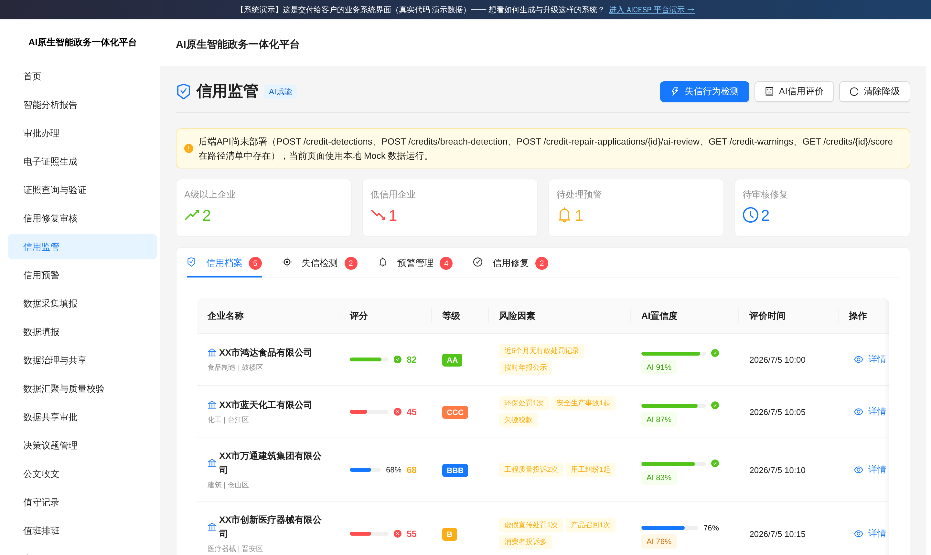
SEE IT LIVE ①
The delivered system's real UI
The business system the client's staff use every day — really generated code · demo data · AI confidence and human review embedded in every step.
LIVE DEMO
Government standard edition · credit-supervision console: AI scores every enterprise with a stated confidence level; low-confidence cases auto-route to human review — AI screens first, humans decide, not badge-engineered AI.
VERIFY IT YOURSELF ONLINE
myaiarch.com/demo/gov →
AICESP · Yandie Intelligent Technology (Beijing) Co., Ltd. · www.myaiarch.com
9 / 26

Slide 10
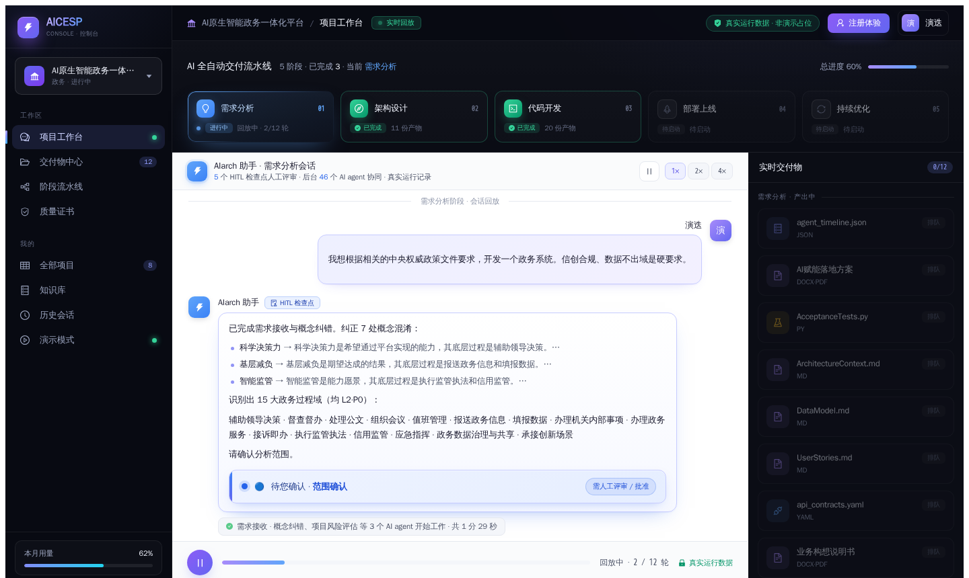
SEE IT LIVE ②
AI production-process replay
Five-stage fully automated pipeline · 46 AI agents in concert · 5 HITL human checkpoints · 12 real-time deliverables · real execution record.
LIVE DEMO
This is the very production line that builds the system: requirement → architecture → code → deployment → continuous optimization, fully replayable and auditable.
VERIFY IT YOURSELF ONLINE
myaiarch.com/platform/demo →
AICESP · Yandie Intelligent Technology (Beijing) Co., Ltd. · www.myaiarch.com
10 / 26

Slide 11
PRODUCT & GO-TO-MARKET
Free acquisition → partner delivery → platform fee
We are a platform, not a direct seller — the channel partner is the client's only touchpoint; the free standard edition is the acquisition engine that feeds the channel.
Standard edition · free
Services · paid
Custom edition · paid
Full former-flagship capability, not stripped down
Provided by channel partners
Built on the standard edition for the scenario
· Two general standard editions (government / enterprise) + a dozen-plus industry editions (mass-produced in hours by the line)
· Deployment from ¥2,000/time · O&M from ¥2,000/month (suggested price · charged by the partner)
· O&M monitoring data = optimization-flywheel input = custom-upgrade leads (the partner's built-in sales funnel)
· Delivery is done entirely by the platform, so partners focus on the client — margin ~60% vs. traditional 10%
· Custom delivery in hours — a rival can take the code but can't modify it; what we modify is the production line
· Full-feature · log in on the public internet and download · full source code + docs + AI Q&A (free self-service training)
· Long term: as clients' AI usage scales → a token-distribution revenue layer
· Platform revenue = platform fee (~20% of contract value) — pure platform gross margin
· Clients bring their own model API keys (entered in the config UI · routing preset by the platform)
Live round: a listed company's LTC platform — the requirement entered the line at 20:02 and full-chain delivery was done by 03:57 the next day (510 files · 43 pages · all acceptance passed). The free standard edition is produced by this very line.
AICESP · Yandie Intelligent Technology (Beijing) Co., Ltd. · www.myaiarch.com
11 / 26

Slide 12
AI enablement for existing systems: their code untouched
12 / 26
The third delivery form — unlocking the entire enterprise installed base: every company runs systems it won't rip out (lowest sales resistance; flywheel accrues to us)
Sidecar
The customer's system keeps running, maintained by its own team; our line generates an AI enablement sidecar alongside it — read/write via open interfaces, interface as contract, their code never modified
On real workflows
AI enablement points land on real activities — orders, tickets, approvals, after-sales — each with an explicit value hypothesis and human checkpoints: concrete productivity, not a generic assistant
Write-back ladder
Against a production system we didn't build, AI authority opens level by level: read-only insights → AI suggests, human executes → human approves write-back → verified auto write-back
Deployment, operations and the optimization flywheel are shared with the whole line — the sidecar is monitored and improved 7×24 from day one; core components field-proven (paying SOE customer; enablement engine ±2%), productization underway
AICESP · Yandie Intelligent Technology (Beijing) Co., Ltd. · www.myaiarch.com

Slide 13
INDUSTRY DEPTH
106 AI consultants, six major industries
Every project's output compiles into the next generation's constraints — more accurate the more it runs, with new industries addable anytime.
Finance
Smart credit decisioning (second-scale) · real-time anti-fraud / AML · KYC review · advisory & cross-selling · smart service (80%+ automation) · post-loan monitoring · compliance reporting ……
Logistics
Dynamic vehicle routing & loading · network-wide capacity optimization · smart quoting · on-time alerts · last-mile dispatch · in-warehouse picking · cold-chain control · anomaly diagnosis ……
Manufacturing
Predictive maintenance · AI visual inspection · dynamic scheduling · generative design & rapid variants · supply-chain risk & auto-replenishment · spare-parts optimization · digital twin ……
Retail
Demand forecasting & auto-replenishment · dynamic / near-expiry pricing · 1-to-1 marketing · smart store ops · omnichannel inventory · AI assortment & forecasting · voice shopping guide ……
Healthcare
AI imaging diagnosis · smart triage · clinical-pathway recommendation · medication-safety review · insurance pre-audit · DRG/DIP cost optimization · bed & OR scheduling · chronic-disease follow-up ……
SaaS / Tech
AI sales-intent scoring · customer-health early warning · R&D Copilot · in-product embedded AI · multi-tenant compliance audit · AIOps self-healing · content marketing & SEO · smart pricing ……
Flywheel compiles quality lessons into the next generation's constraints. Three-layer pluggable — add an industry = add a data file · 0 kernel change.
Cross-industry transfer: an enum-drift constraint found in a government project → automatically protects a bank approval flow (proven).
AICESP · Yandie Intelligent Technology (Beijing) Co., Ltd. · www.myaiarch.com
13 / 26

Slide 14
METHODOLOGY
AEBT: a three-layer pluggable architecture
Not homegrown — decades of top-tier consulting & engineering (IBM / Huawei / Deming / Six Sigma), compiled into the platform.
Layer 1
Universal kernel
Industry- & domain-agnostic: strategy analysis (VCW) → process design → requirement → design → implementation. Quality skeleton = dual-benchmark generation constraints (Huawei depth 9 dimensions + Palantir AI-usage 8 dimensions) + deterministic gates + a refinement ladder.
Layer 2
Industry capability packs
Pure data: maturity models / value chains / KPI benchmarks / regulatory constraints / known pitfalls / AI use-case library — injected only, never modifying the kernel.
Layer 3
Domain capability packs
Orthogonal to industry: subject domains such as risk control / core systems / supply chain, using the same injection mechanism.
Five invariants guarantee 'industry/domain never pollutes the universal': one-way dependency · context injection only · runs with no pack · packs isolated from one another · government = peer-level mode.
Fused external methodologies (well grounded): IBM SPEED / MBI / WPD 50+ work-product library · IBM I/T strategy & planning + Gartner TIME · Huawei EFIL + ISC A-F · Deming TQM (PDCA) + GE Six Sigma (DMAIC).
AICESP · Yandie Intelligent Technology (Beijing) Co., Ltd. · www.myaiarch.com
14 / 26

Slide 15
THE TECHNICAL MOAT
Quality system: feed-forward first
Calling the same LLMs — why do AICESP's systems run while competitors' don't? The answer is the quality system.
Generation constraints
QA · fix the line
Derive from scientific frameworks → pair gate ↔ constraint → feed the constraint forward so the generator is 'right the first time'. Every deterministic gate has a paired generation constraint; a parameterized guard auto-detects any missing injection.
Gates + refinement
QC · fix defects
Multi-dimensional review → deterministic mechanical fix (0-LLM) + semantic surgical refinement + three-model adversarial adjudication to remove false positives → bounded repair loop.
Factory certificate
QC · inspection
Generability certificate + benchmark_ready (static PASSED + import smoke test + all runtime acceptance passed). If it fails it is honestly BLOCKED — never forced out the door.
Every one of the eight quality dimensions is anchored to an authoritative standard: ISO 25010 · IEEE 1016 · Palantir AIP · OWASP · China MLPS 2.0 · IEEE 830 — not invented by us.
Model independence Quality is guaranteed by platform mechanisms; the LLM is a swappable inference engine — swapping the base model (deepseek / Kimi / Zhipu) has a negligible measured effect on delivery quality. AICESP is the distribution channel through which LLMs enter government & enterprise systems, so no single model's price or policy change is a single point of risk.
AICESP · Yandie Intelligent Technology (Beijing) Co., Ltd. · www.myaiarch.com
15 / 26

Slide 16
ENGINEERING
Strongest coding agent + domestic compliance
We don't build our own code generator — we take the industry's strongest coding agent as the Coder, and the platform 'waits on' it to do its best.
Collaboration philosophy
Serve, don't be served: the platform pre-writes artifacts into the Coder's most convenient format and delivers them proactively, event-driven — saving the Coder's attention, not the platform's compute.
Division of labor
The platform owns the deterministic ground-truth (tenant isolation / SQL red lines / government compliance / security); semantics and design intent are left to the Coder.
Three stages
Context prep (deterministic · no LLM) → Coder writes front + back end (finishing auto-triggers QC) → quality pipeline (gate → adjudicate → bounded repair → certify → runtime acceptance).
Government compliance
Production inference runs on domestic LLMs (deepseek / Kimi / Zhipu) — requests go only to domestic endpoints; code and data never leave the country, meeting Xinchuang & government data-security requirements.
Project isolation
The Coder runs only under a dedicated project root, with every file read/write guarded — never touching platform code or other projects.
Layers: platform ── Agent SDK (launch + constraints) ── Claude Code (the Coder that does the real work) ── domestic LLM (inference only)
AICESP · Yandie Intelligent Technology (Beijing) Co., Ltd. · www.myaiarch.com
16 / 26

Slide 17
COMPETITION
Three cost structures, fundamentally different
Compute-intensive — achieving both a 7/8 saving for the client and high gross margin for AICESP.
Salesforce / ServiceNow
frontier SaaS
Big-tech FDE
humans + AI-assisted
AICESP
AI-led · no on-site staffing
Delivery quality
Limited by ecosystem boundaries
Variable · often ships with defects
16-dimension acceptance · Critical=0 · no ship until it passes
Delivery cycle
Standard modules 2–6 months + SI customization
Weeks to months (engineer-availability bound)
Full chain completed in hours
Cost
Annual fee + SI implementation, continually accumulating
Labor is the cost body · incompressible
Compute replaces labor · a different cost structure
Gross margin
High platform margin but low client ROI
Labor-led, with a clear ceiling
Pure compute ≈100%
Planned pricing: government ¥15,000–¥50,000 / enterprise ¥6,000–¥25,000 (comparable market projects cost millions).
AICESP · Yandie Intelligent Technology (Beijing) Co., Ltd. · www.myaiarch.com
17 / 26

Slide 18
UNIT ECONOMICS
The platform-fee model
Not 'better at haggling' but a fundamentally different cost structure — a win-win, not a zero-sum game.
Traditional SI
AICESP
Market contract value
RMB 6–8M
Agreed delivery fee RMB 1M (~1/8 of market price)
Actual cost
Labor is incompressible; a year of work may still not finish it
token-level (on the order of tens of RMB)
Gross margin
Perennially loss-making
≈100% (pure compute)
Delivery quality
Variable, heavily people-dependent
Critical=0, machine acceptance
The client saves 7/8 while the platform keeps high margin — the cost body is compute (trending to zero as models commoditize), whereas traditional delivery's cost body is labor (incompressible).
Example: the bank office system (a partner's real bid) · actual pricing depends on project scale.
AICESP · Yandie Intelligent Technology (Beijing) Co., Ltd. · www.myaiarch.com
18 / 26

Slide 19
HOW WE ENGAGE
Day 1 morning to Day 2 — all delivered
Upload files or hold a half-day workshop, and receive a complete runnable system on Day 2.
Day 1 morning
You upload files / a half-day workshop
The three-layer AEBT framework completes strategy-layer analysis · a draft path for reconstructing competitive advantage · a list of core processes to refactor with AI as the subject.
Day 1 afternoon
You confirm the direction
Requirement delivery package of 9 documents (business vision · requirement spec · API contracts · 40+ executable acceptance tests) · quality-gate validation · data model & architecture context all ready.
Day 2
You demo and accept
Design package of 6 documents · development package (full source + install & deployment guide + test report PASSED + user manual + O&M guide) · 16-dimension acceptance · Critical=0 · the improvement flywheel starts in sync.
Every day thereafter
AI takes over automatically
Four-step flywheel · discover → focus → implement → verify · auto-produces improvement requirements · zero human trigger · AI capability keeps accruing.
Service fee is 1–5% of traditional consulting, 10% of big-tech FDE.
AICESP · Yandie Intelligent Technology (Beijing) Co., Ltd. · www.myaiarch.com
19 / 26

Slide 20
THE MOAT
Six moats, deepening with use
It addresses the human-activity reality of running large organizations — the first mover's generational lead widens exponentially.
① Full-chain platform
② Machine-verifiable gates
③ Methodology moat (AEBT)
All four links joined: strategy → design → delivery → improvement. Big players solve only one link and won't touch low-price heavy-customization work; AICESP joins the full chain, replacing labor with compute.
Only Critical=0 advances; ambiguity is eliminated at design. Dual benchmark: vertical Huawei IT-planning depth + horizontal Palantir AI-usage standard.
An AI realization of the IBM IGS global consulting methodology, 106 agents mapped to authoritative frameworks. A traditional team needs months; our agent swarm needs hours.
▸ failures honestly blocked, never shipped with defects
▸ 20 invention patents pending · three-layer pluggable · 0 kernel change
▸ government hours-scale · central SOE 12 planning docs
④ Knowledge flywheel
⑤ Self-iteration
⑥ Supply-chain de-risking
Every defect happens once — after diagnosis a gate+constraint pair is auto-generated and injected before generation, so the defect isn't produced at the source.
Every project's output feeds back — the constraint library, industry knowledge and quality benchmarks update automatically, so the platform grows stronger the more it runs.
A multi-backend architecture at the coder-orchestration layer (deepseek / Kimi / Zhipu already swapped in testing · a local open-weights route under construction).
▸ a gov-doc enum constraint → auto-inherited by a bank approval flow · else BLOCKED
▸ no reliance on manual maintenance
▸ quality lives in the constraint system & gates, not any single model
Without fifty-plus years of experience, a deviation in any single step breaks the whole system.
AICESP · Yandie Intelligent Technology (Beijing) Co., Ltd. · www.myaiarch.com
20 / 26

Slide 21
WHY IT COMPOUNDS
Six-layer mother architecture
Each layer is the mother of the one below. Rivals can copy L0's screenshots, but not L2/L3's slope — and even less L4's organizational form.
L4·L5
Governance layer (Cabinet) + humans
L4 tiered rescript handles requests on humans' behalf · L5 humans handle only creativity and exceptions.
L3
AIarch · agent capability system
Memory / skills / methods compound continuously — the improver itself grows stronger.
L2
AIcevo · self-evolution layer
The line that improves the line: spot opportunity → charter → implement → verify.
L1
AICESP · mother platform
The line that generates systems: requirement → design → code → documents, fully automated.
L0
AIone · delivered-system product family
The runnable system the client receives (government / enterprise / industry editions).
The derivative view: L0 position · L1 velocity · L2 acceleration · L3 jerk · L4 lets one person command any scale — the higher the layer, the harder to copy.
AICESP · Yandie Intelligent Technology (Beijing) Co., Ltd. · www.myaiarch.com
21 / 26

Slide 22
SELF-EVOLUTION
AIcevo: you buy the acceleration, not today's line
A built-in three-source improvement-opportunity discovery system — delivery capability keeps strengthening as it runs.
Retrospective source
Prospective source
Benchmark source
Every production round auto-harvests improvement signals
Future risks assessed before incidents occur
The gap to industry benchmarks is the opportunity
Semantic-review conclusions / repair-round counts / residual lists — each turn of the line auto-emits an 'Improvement Opportunity List'.
FMEA failure-mode ledger: ask 'how could it fail' of every step, rank by risk priority number, and add detection & constraints first.
Continuously score against authoritative engineering standards — gaps quantified into improvement charters, not guesswork.
Operating discipline: every production round (pass or honestly blocked) must produce an opportunity list → charter → implement → verify next round — the failed rounds are the richest ore.
We apply the same method to ourselves first: AICESP's strategy, process and iteration are equally AI-driven — we promise clients continuous success on the strength of making ourselves continuously successful first.
AICESP · Yandie Intelligent Technology (Beijing) Co., Ltd. · www.myaiarch.com
22 / 26

Slide 23
PATHS TO SCALE
Three paths to scale
A channel-partner network that pulls partners in — and free software that acquires at the top of funnel.
Path 1 The channel-partner network
Before the product even launched, channel partners came knocking; traditional collaboration-software vendors, squeezed for years by high delivery costs, dare not take large custom projects at all.
Traditional channel partner (today)
AICESP channel partner (new model)
AICESP channel partner (new model)
delivery labor 70% sales 20% profit 10%
platform fee 20% sales 20% profit 60% ↑6×
Path 2 Free software for acquisition
· What's free is the full-feature standard-edition system (the generated software), not the platform — we give away the egg, not the hen.
· Enterprises download for free and self-deploy, or pay us to do it (deployment from ¥2,000/time · O&M from ¥2,000/month).
· A rival taking the code only gets a fixed snapshot; AICESP makes custom changes within hours — adapting on demand is a natural lock-in.
· Clients call AI with their own keys: usage grows with the business → a long-term token-distributor revenue layer.
Path 3 AI enablement for existing systems: customer's system untouched; an AI sidecar runs alongside — unlocking the entire installed base (lowest sales resistance; flywheel accrues to us; productization underway)
AICESP · Yandie Intelligent Technology (Beijing) Co., Ltd. · www.myaiarch.com
23 / 26

Slide 24
ORGANIZATIONAL MOAT
The Cabinet breaks the seven-person bottleneck
Human orgs peak at about seven people (communication cost grows with the square of headcount). Our governance model outperforms a seven-person org — one person commands an AI army of any size.
Bottleneck
Solution: a Ming-Cabinet replica
Already running
Humans are the platform's ceiling
Tiered rescript · compressing exceptions
Applied to ourselves first
· Request bombardment: every yes/no waits on a human
· On-duty Grand Secretaries answer from a predefined rule base
· Permission watch: AI answers tool requests by rule · a fully logged ledger
· Decision quality decays with organization size
· Tier C auto-approved / Tier B approved then reported / Tier A batched onto a memorial for humans
· Memorials / after-the-fact reports: automated watch every half hour
· The traditional fix = add people → even higher communication cost
· Each new exception a human answers → becomes a rule → never asked again: request volume falls monotonically
· The platform's daily operation is driven by this very model — what you buy is a proven organizational form
Only a handful of such companies appear each technological era: organizations whose decision quality does not decay with scale. To judge whether we are one, you needn't believe this page — the live verification from page 3 applies here just as well.
AICESP · Yandie Intelligent Technology (Beijing) Co., Ltd. · www.myaiarch.com
24 / 26

Slide 25
THE ASK
Seed round: RMB 6M · pre-money RMB 60M
Clear terms · defined use of proceeds · verifiable milestones (planning basis · the final agreement prevails).
Raise amount
Pre-money valuation
Post-money valuation
Equity offered
RMB 6 million
RMB 60 million
RMB 66 million
~9.1%
Use of proceeds (18 months of runway reserved · executed on a 3-month cadence · compute first)
40%
Compute & line operation: LLM token procurement and multi-vendor access · the line running around the clock
25%
Productization & compliant launch: multi-tenant SaaS-ization · ICP filing / trademark / security compliance · canary release
20%
Marketing & channel: free base edition for acquisition · the channel-partner system · first batch of industry editions to market
15%
Core team: a few key roles in AI-operations engineering and business development — humans do only creativity and exceptions
Dual-track milestones (by the physics of procurement, not by wishes): Fast track — ¥2,000-class deployment/O&M orders fall within the no-tender threshold and close in days, landing in volume from month T+1 (platform-fee revenue ramps immediately). Slow track — government/enterprise custom tenders run 3–6 months, presented as shortlist / active pipeline. By T+9: channel network ≥20 partners · paying clients ≥10 · launching Series A on a real revenue curve.
AICESP · Yandie Intelligent Technology (Beijing) Co., Ltd. · www.myaiarch.com
25 / 26

Slide 26
TEAM & NEXT STEPS
We make next quarter verifiable
We don't forecast ten years — we make the next quarter verifiable.
Fan Jiankang · Founder
Jiang Ping · Co-founder
Huawei IT / Southwest Securities Feihu.net / founder of a rapid webapp-development platform / e-government advisor to several ministries and local governments
Huawei IT / long-time practitioner of IBM methodology / full participant in Huawei IT planning & implementation / project manager on several major programs
25+ years of hands-on experience each · 20 invention patents pending · 106 specialized AI agents
· AICESP is a platform with no business logic — feed in any country's requirements and it generates code for that country's needs. An English edition is coming, aimed at the global market.
· Zero-risk entry: a free half-day diagnosis · no payment if the POC disappoints.
· Data security: everything stays on the client's intranet · source code belongs to the client.
· Adapt as needed: from a new requirement to new code implementation, in hours.
· Service fee: 1–5% of traditional consulting, 10% of big-tech FDE.
Website www.myaiarch.com · Fan Jiankang · invest@aicesp.cn
AICESP · Yandie Intelligent Technology (Beijing) Co., Ltd. · www.myaiarch.com
26 / 26

